Slide 1
Software Engineering BCA IV SEM
Software Development Process Model
Bijay Babu Regmi
bijay.regmi@deerwalk.edu.np

Slide 2
Software Process
A software process is the set of activities and associated outcome that produce a software product. Software engineers mostly carry out these activities:
- software specifications
- define the main functionalities of software and constraints around them
- software development
- software is to be designed and programmed
- software validation
- software must confirm to it’s specification and meets the customer’s need
- software evolution
- software is being modified to meet customer and market requirements changes

Slide 3
Software Process Model
A specified definition of a software process, which is presented from a particular perspective
by their nature, software process model is an abstraction of the actual process, which is being described.
Process models may contain activities, which are part of the software process, software product, and the roles of people involved in software engineering
Examples:
- Workflow model
- Waterfall model
- Dataflow model
- Evolutionary Development model

Slide 4
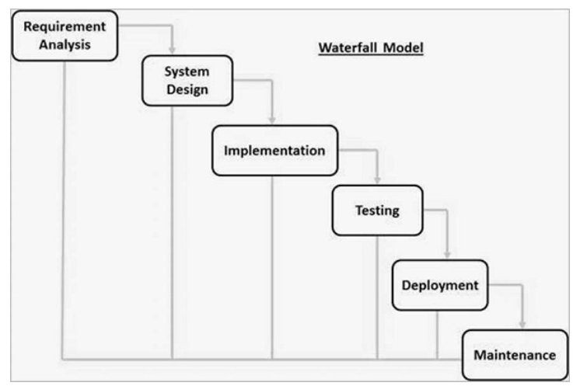
Waterfall Model
is a sequential approach, where each fundamental activity of a process represented as a separate phase, arranged in linear order
must plan and schedule all of the activities before starting working on them (plan-driven process)

Slide 5
Continued….
Requirement gathering and analysis:
- All possible requirements of the system to be developed are captured in this phase and documented in a requirement specification document
System design:
- system design is prepared based on the requirement specifications from first phase
- helps in specifying hardware and system requirements and helps in defining the overall system architecture
Implementation:
- With inputs from the system design, the system is first developed in small programs called units
- Each unit is developed and tested for its functionality, which is referred to as Unit Testing.
Integration and Testing:
- All the units developed in the implementation phase are integrated into a system after testing of each unit.

Slide 6
Continued….
Deployment of system:
- Once the functional and non-functional testing is done; the product is deployed in the customer environment or released into the market
Maintenance:
- Once your system is ready to use, you may later require change the code as per customer request
- Maintenance is done to deliver these changes in the customer environment

Slide 7
Evolutionary Model
are basically iterative
Once the requirements are analyzed, they pass through a series of iterations till the complete software is developed.
The evolutionary models mainly support the programmer to develop the complete version of a software.
After each release, based on the review given by the reviewers, further iterations are performed.
involves more user interaction in every iteration, and thereby increasing reliability
Two main evolutionary models are:
- Incremental model
- Spiral model

Slide 8
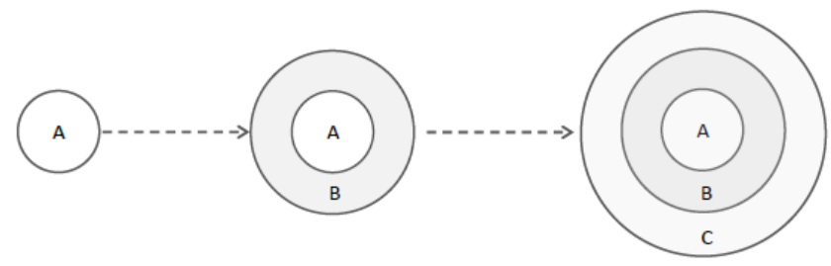
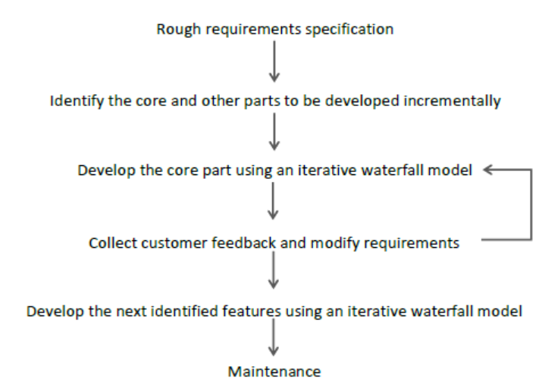
Continued….
Fig: Evolutionary Development of a software product
Fig: Evolutionary model of software development

Slide 9
Advantages of Evolutionary Model
Normally very useful for very large products
User gets a chance to experiment with a partially developed software much before the complete version of the system is released.
helps to accurately elicit user requirements during the delivery of different versions of the software
avoids the need to commit large resources in one go for development of the system

Slide 10
Disadvantages of Evolutionary Model
Difficult to divide the problem into several versions that would be acceptable to the customer and which can be incrementally implemented and delivered
client involvement is more and it is not always considered by the developer
a slow process because it takes more time for development
can be costly to develop a software model

Slide 11
Component Based Software Engineering (CBSE)
an approach to software development emerged in the 1990's that relies on the reuse of entities called 'software components'
emerged from the failure of object-oriented development to support effective reuse
Single object classes are too detailed and specific.
Components are more abstract than object classes and can be considered to be stand-alone service providers.
They can exist as stand-alone entities.
CBSE essentials:
- Independent components specified by their interfaces.
- Component standards to facilitate component integration.
- Middleware that provides support for component inter-operability.
- A development process that is geared to reuse.

Slide 12
CBSE and design principles
Apart from the benefits of reuse, CBSE is based on sound software engineering design principles:
- Components are independent so do not interfere with each other;
- Component implementations are hidden;
- Communication is through well-defined interfaces;
- One components can be replaced by another if its interface is maintained;
- Component infrastructures offer a range of standard services.
Components provide a service without regard to where the component is executing or its programming language.
A component is an independent executable entity that can be made up of one or more executable objects. The component interface is published and all interactions are through the published interface.

Slide 13
Characteristics of a component
Composable:
- must provide external access to information about itself, such as its methods and attributes.
- all external interactions must take place through publicly defined interfaces
Deployable:
- must be able to operate as a stand-alone entity on a component platform that provides an implementation of the component model
Documented:
- have to be fully documented so that potential users can decide whether or not the components meet their needs
Independent:
- should be possible to compose and deploy it without having to use other specific components
Standardized:
- a component used in a CBSE process has to conform to a standard component model

Slide 14
Process Iteration
two process models have been designed to support process iteration:
-Incremental Delivery: The software specification, design and implementation are broken down into a series of increments that are each developed in turn.
-Spiral Development: The development of the system spirals outwards from an initial outline through to the final developed system.

Slide 15
Incremental Delivery
The waterfall model of development requires defining the requirements for a system before design begins. On contrary, an evolutionary development allows requirements to change but it leads to software that may be poorly structured and difficult to understand and maintain.
is an approach that combines the advantages of these two models
customers identify the services to be provided by the software system
They decide which subset of the services is most important and which are least important to them.
A number of delivery increments are then defined, with each increment providing a sub-set of the system functionality.
The allocation of services to increments depends on the priority of service. The highest priority services are delivered first.
Once the system increments have been identified, the requirements for first increment are defined in detail, and that increment is developed using the best suited software process.

Slide 16
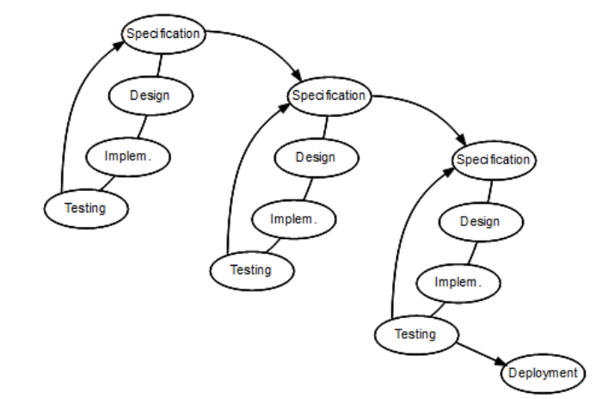
Continued….
Fig: Incremental Development

Slide 17
Advantages
The first increment satisfies their most critical requirements so they can use the software immediately.
As the highest priority services are delivered first, and later increments are integrated with them, it is unavoidable that the most important system services receive the most testing.
There is a lower risk of overall project failure. Although problems may be encountered in some increments, it is likely that these will be solved in later versions.

Slide 18
Spiral Development
represents the software process as a sequence of activities with some backtracking from one activity to another, the process is represented as a spiral
Each loop in the spiral represents a phase of the software process.
Thus, the innermost loop might be concerned with system feasibility, the next loop with requirements definition, the next loop with system design and so on.
Each loop in the spiral is split into four sectors:
Objective setting: Specific objectives for that phase of the project are defined. Constraints on the process and the product are identified and a detailed management plan is drawn up. Project risks are identified. Alternative strategies, depending on these risks, may be planned.
Risk assessment and reduction: For each of the identified project risks, a detailed analysis is carried out. Steps are taken to reduce the risk.
Development and validation: After risk evaluation, a development model for the system is chosen.
Planning: The project is reviewed and a decision made whether to continue with a further loop of the spiral. If it is decided to continue, plans are drawn up for the next phase of the project.

Slide 19
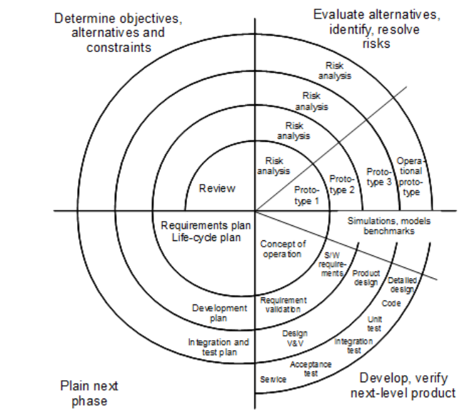
Continued….
Fig: Spiral model of Software process

Slide 20
Agile Methods
An agile approach to development is essentially a results-focused method that iteratively manages changes and risks.
It also actively engages customers in providing feedback on successive implementations, in effect making them part of the development team. Unlike process-driven documentation, it promotes outcome-driven documentation.
The emphasis of agile practices is on traveling lightweight, producing only those artifacts (documentation) that are absolutely necessary.
Agile methods are often focused on how to run the development process (“project management”), perhaps using the tools for software development inherited from other methods, but in a different way.

Slide 21
Continued….
Development in Agile method:
- Design and Implementation are considered to be the central activities in the software process.
- Design and Implementation phase also incorporate other activities such as requirements elicitation and testing into it.
- iteration occurs across activities. Therefore, the requirements and the design are developed together, rather than separately.
- The allocation of requirements and the design planning and development as executed in a series of increments.
- An agile process focuses more on code development rather than documentation.

Slide 22
Extreme Programming
Extreme Programming (XP), an Agile software development framework, is specifically designed for improving the quality of the software, the work process for the development team and increased customer satisfaction.
It is a method devised for a smoother and efficient software development life cycle (SDLC) for your projects, and it was first implemented on a project on March 6, 1996.
Why XP?
- Extreme Programming works towards providing iterative and recurrent software releases throughout the project; instead of everything together after a single, long project development lifecycle.
- These short iterative cycles help both team members and customers to assess and review the project’s progress throughout its development.

Slide 23
Continued….
What is XP made of?
XP incorporates the following 5 values:
- Communication: Software Development projects or projects in any industry rely heavily on communication. XP focuses on effective communication between the team and the customer.
- Simplicity: XP looks for the simplest ways to get things done. This means to do what is essential thereby reducing waste, address only the known issues and keeping the design simple for effective creation and maintenance.
- Feedback: Feedback plays an important role in project improvement. XP encourages instantaneous feedback. This helps the team identify room for improvement and revise practices.
- Respect: The team must respect each other both personally and professionally, to achieve goals.
- Courage: XP endorses courage at all levels. This can include speaking up against what does not work and anything that affects the project’s effectiveness, or accept feedback and improve methodologies.

Slide 24
Continued….
Applications of Extreme Programming:
Some of the projects that are suitable to develop using XP model are given below:
- Small projects: XP model is very useful in small projects consisting of small teams as face to face meeting is easier to achieve.
- Projects involving new technology or Research projects: This type of projects face changing of requirements rapidly and technical problems. So XP model is used to complete this type of projects.

Slide 25
Rapid Application Development
RAD is a linear sequential software development process model that emphasizes a concise development cycle using an element based construction approach. If the requirements are well understood and described, and the project scope is a constraint, the RAD process enables a development team to create a fully functional system within a concise time period.
This model consists of 4 basic phases:
Requirements Planning:
- involves the use of various techniques used in requirements elicitation like brainstorming, task analysis, form analysis, user scenarios, FAST (Facilitated Application Development Technique), etc.
User Description:
- This phase consists of taking user feedback and building the prototype using developer tools. In other words, it includes re-examination and validation of the data collected in the first phase. The dataset attributes are also identified and elucidated in this phase.

Slide 26
Continued….
Construction:
- In this phase, refinement of the prototype and delivery takes place. It includes the actual use of powerful automated tools to transform process and data models into the final working product. All the required modifications and enhancements are too done in this phase.
Cutover:
- All the interfaces between the independent modules developed by separate teams have to be tested properly. The use of powerfully automated tools and subparts makes testing easier. This is followed by acceptance testing by the user.

Slide 27
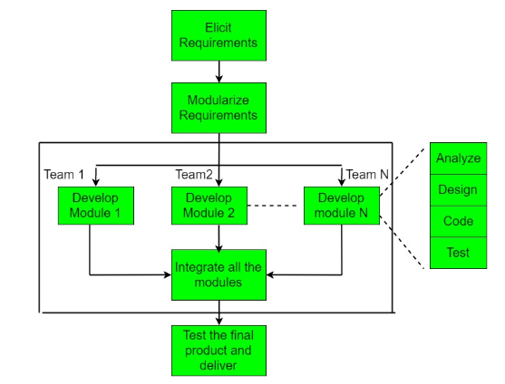
Continued….

Slide 28
Advantages and Disadvantages
Advantages:
- This model is flexible for change.
- In this model, changes are adoptable.
- Each phase in RAD brings highest priority functionality to the customer.
- It reduced development time.
- It increases the reusability of features.
Disadvantages:
- It required highly skilled designers.
- All application is not compatible with RAD.
- For smaller projects, we cannot use the RAD model.
- On the high technical risk, it's not suitable.
- Required user involvement.

Slide 29
Software Prototyping
It is the process of implementing the presumed software requirements with an intention to learn more about the actual requirements or alternative design that satisfies the actual set of requirements .
Need for software prototyping:
-To assess the set of requirements that makes a product successful in the market
-To test the feasibility without building the whole system.
-To make end-user involved in the design phase

Slide 30
Phases of prototyping
Define the prototype objective:
- This step involves understanding the very basics product requirements especially in terms of user interface. The more intricate details of the internal design and external aspects like performance and security can be ignored at this stage.
Define the objective:
- The initial Prototype is developed in this stage, where the very basic requirements are showcased and user interfaces are provided. These features may not exactly work in the same manner internally in the actual software developed. While, the workarounds are used to give the same look and feel to the customer in the prototype developed.

Slide 31
Continued….
Develop a prototype:
- The prototype developed is then presented to the customer and the other important stakeholders in the project. The feedback is collected in an organized manner and used for further enhancements in the product under development.
Evaluate prototype:
- The feedback and the review comments are discussed during this stage and some negotiations happen with the customer based on factors like – time and budget constraints and technical feasibility of the actual implementation. The changes accepted are again incorporated in the new Prototype developed and the cycle repeats until the customer expectations are met.

Slide 32
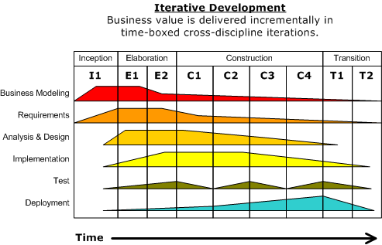
Rational Unified Process (RUP)
is an agile software development process
a software development process from Rational, a division of IBM
divides the development process into four distinct phases that each involve business modeling, analysis and design, implementation, testing and deployment
four phases:
- Inception
- Elaboration
- Construction
- Transition

Slide 33
Continued….
Inception:
- The idea for the project is stated. The development team determines if the project is worth pursuing and what resources will be needed.
Elaboration:
- The project's architecture and required resources are further evaluated. Developers consider possible applications of the software and costs associated with the development.
Construction:
- The project is developed and completed. The software is designed, written, and tested.
Transition:
- The software is released to the public. Final adjustments or updates are made based on feedback from end users.

Slide 34
Computer Aided Software Engineering (CASE)
is the application of computer-assisted tools and methods in software development to ensure a high-quality and defect-free software
ensures a check-pointed and disciplined approach and helps designers, developers, testers, managers and others to see the project milestones during development
also serve as a repository for project-related documents like business plans, requirements and design specifications
Advantages:
- As special emphasis is placed on redesign as well as testing, the servicing cost of a product over its expected lifetime is considerably reduced.
- The overall quality of the product is improved as an organized approach is undertaken during the process of development.
- Chances to meet real-world requirements are more likely and easier with a computer-aided software engineering approach.
- CASE indirectly provides an organization with a competitive advantage by helping ensure the development of high-quality products.

Slide 35
CASE Tools
is the automation of step by step methodologies for software and system development
are characterized by the stage or stages of software development life cycle on which they focus
Since different tools covering different stages share common information, it is required that they integrate through some central repository system (data dictionary) to have a consistent view of such information.
In phases of software development life cycle, integrated through a central data dictionary.
Types of CASE tools:
- Diagramming Tools
- Computer Display and Report Generators
- Analysis Tools
- Central Repository
- Documentation Generators
- Code Generators

Slide 36
Types of CASE Tools
Diagramming Tools:
- helps in diagrammatic and graphical representations of the data and system processes
- represents system elements, control flow and data flow among different software components and system structure in a pictorial form
- For example, Flow Chart Maker tool for making state-of-the-art flowcharts.
Computer Display and Report Generators:
- helps in understanding the data requirements and the relationships involved
Analysis Tools:
- focuses on inconsistent, incorrect specifications involved in the diagram and data flow
- helps in collecting requirements, automatically check for any irregularity, imprecision in the diagrams, data redundancies or erroneous omissions
- For example: Accept 360, Accompa, Case Complete, Visible Analyst

Slide 37
Continued….
Central Repository:
- provides the single point of storage for data diagrams, reports and documents related to project management
Documentation Generator:
- helps in generating user and technical documentation as per standards. It creates documents for technical users and end users. For example, Doxygen, DrExplain, Adobe RoboHelp for documentation.
Code Generators:
- aids in the auto generation of code, including definitions, with the help of the designs, documents and diagrams.

